Slide 1
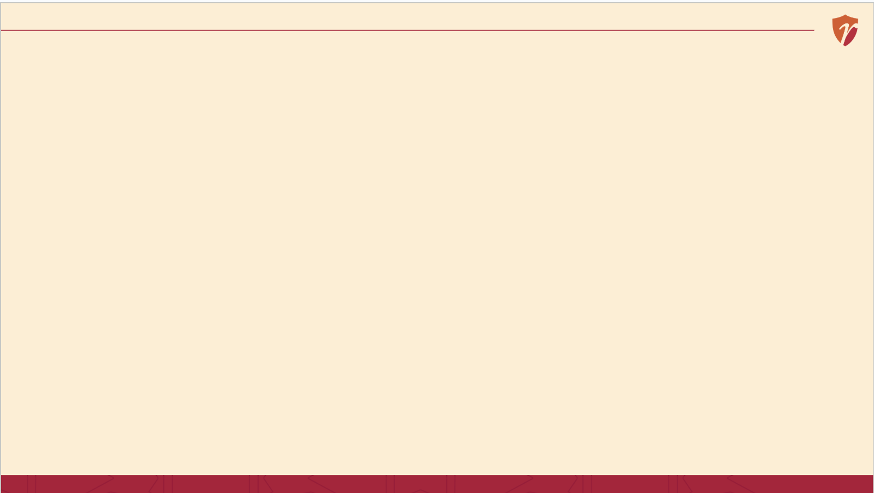
RECAP
Last Session

Slide 2
What are Resources?

Slide 3
Resources, Capability, Competency
Resource is a source of supply, support, or available means to function or reach a goal.
Capability: The organization’s ability to use its resources to perform a particular activity effectively.
Competency: The organization’s proven ability to perform an activity better than competitors or create superior value

Slide 4
CORE CONCEPT 1
Four Kinds of Resources
Framework based on: A. Nag, Strategic Management: Analysis, Implementation and Control, Ch. 5.
7 / 17

Slide 5
CORE CONCEPT 1
Four Kinds of Resources
Physical
Financial
Human
Intangible
Buildings, equipment, inventory
Cash, credit, access to capital
People and their skills
Brand, reputation, patents, culture
Framework based on: A. Nag, Strategic Management: Analysis, Implementation and Control, Ch. 5.
7 / 17

Slide 6
BACK TO PRIYA'S MOMOS
Her Four Resource Types
Physical
Her cart, steamer, and cooking equipment
Financial
Her monthly budget and small savings buffer
Human
Herself, and the helper she hires on weekends
Intangible
Her reputation for fresh, reliable food among regulars
“Priya's Momos” is a fictional business created for classroom illustration only.
13 / 17

Slide 7
CLASS ACTIVITY · 10 MINUTES
Resource or Competence?
For each item, call out: is this a resource, or a competence built from resources?
“A fleet of 500 delivery vans”
“The ability to deliver any order within 2 hours”
“₹10 crore in the bank”

Slide 8
WHY THIS MATTERS
Why This Distinction Matters for a Founder
15 / 17

Slide 9
WHY THIS MATTERS
Why This Distinction Matters for a Founder
1
Investors fund resources, but they bet on competencies what you can actually do with what you're given
2
Two businesses can have identical resources and completely different outcomes, based on competence
3
Knowing your weakest resource tells you exactly what to fundraise, hire, or build for next
15 / 17

Slide 10
SUMMARY
Key Takeaways from Today
Four resource types: physical, financial, human, and intangible
Resources are things you have; competencies are what you can do with them
Sun Tzu priced out an army's resources 2,500 years ago — and warned that even strong resources drain if not actively protected
Investors fund resources, but they bet on competencies

Slide 11
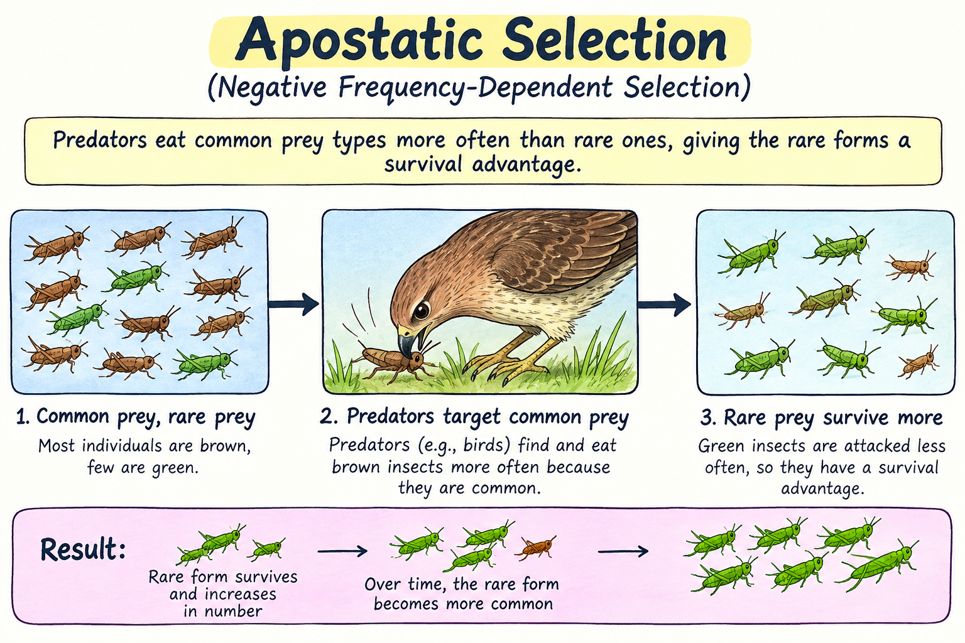
Term of the day
Apostatic Selection

Slide 12
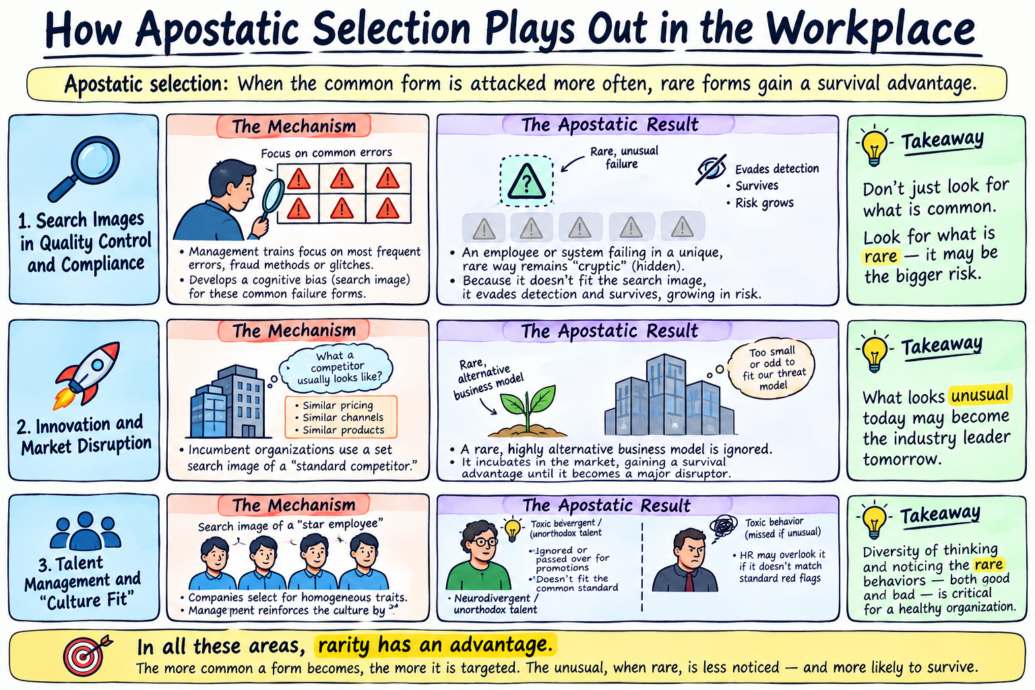
Term of the day
Apostatic Selection

Slide 13
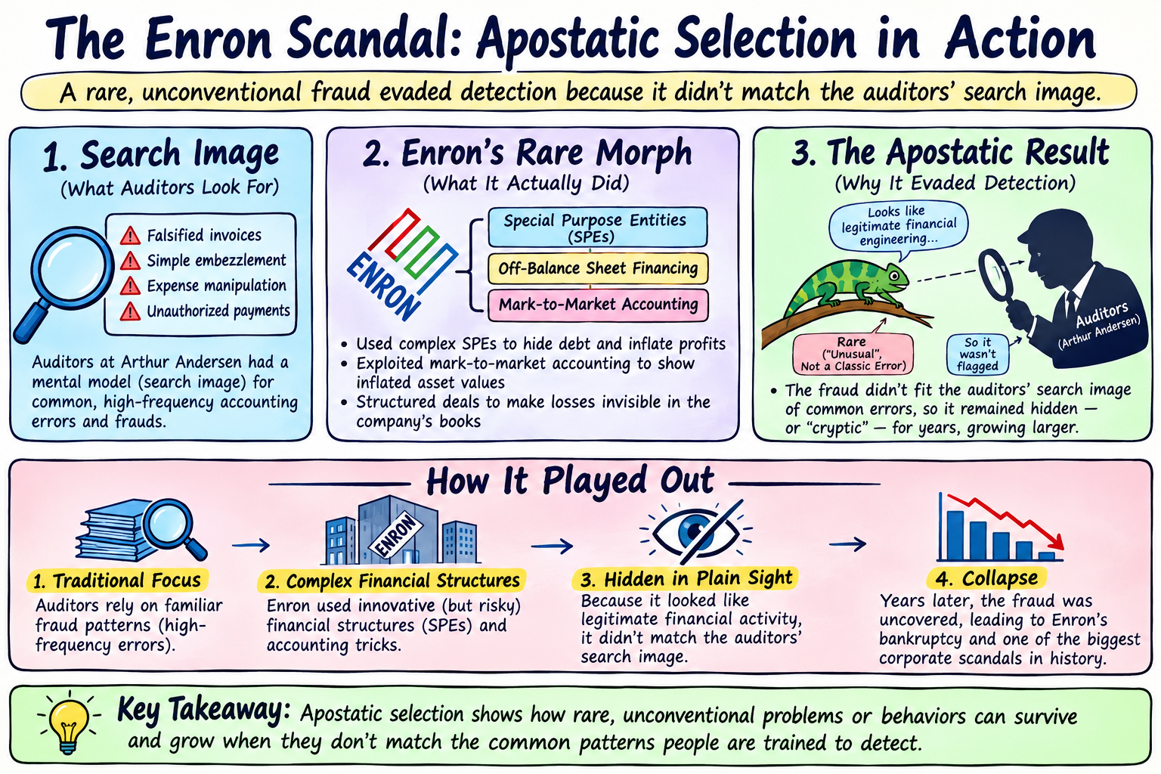
Term of the day
Apostatic Selection

Slide 14
17 / 17
Unit 1 complete.
A quick recap

Slide 15
Quick Recap
Building blocks of strategy
Mission
Why we exist
Goal
What we want to achieve over the long term
Planning
Objectives
What we're specifically trying to achieve
Strategy
Decision-Making
Policy
The standing guidelines we follow
Formulating
Evaluating
Program
The time-bound activities we run
Procedure
The exact steps we repeat
Budget
The numbers behind it all
Tactic
The quick moves we make in the moment

Slide 16
TEN PRINCIPLES · PART 1
Principles 1–5: Setting the Direction
1
Strategy is about the future
Decided today, played out over years
2
Strategy needs trade-offs
You cannot be everything to everyone
3
Strategy must fit the environment
What works depends on the world outside
4
Strategy must fit your capabilities
Ambition without resources is a wish
5
Strategy aims for lasting advantage
Not just one good quarter
General strategic-management principles synthesized for classroom use; see A. Nag, Ch. 1.
6 / 15

Slide 17
TEN PRINCIPLES · PART 2
Principles 6–10: Making It Real
6
Top management sets it, everyone implements it
Strategy needs buy-in at every level
7
Strategy always involves risk
No guaranteed outcomes, ever
8
Strategy must stay flexible
Rigid plans break when conditions change
9
Strategy is only as good as its execution
A brilliant plan, poorly run, still fails
10
Strategy needs continuous evaluation
Check it's working; correct course early
General strategic-management principles synthesized for classroom use; see A. Nag, Ch. 1.
7 / 15

Slide 18
Quick Recap 2 of 8
4 / 17
Strategy Levels: Corporate, SBU, Functional
Corporate
SBU (Business Unit)
Functional
Which businesses to be in. Reliance deciding to enter telecom with Jio.
How to win within one business. Jio's pricing war within telecom specifically.
How each department executes. Jio's network rollout, marketing, and pricing teams each playing their part.

Slide 19
Quick Recap 3 of 8
5 / 17
PESTEL & Environmental Scanning
Political · Economic · Social · Technological · Environmental · Legal
Nokia's decline: a technological shift (touchscreen smartphones) it scanned for too slowly. Demonetisation (2016) and GST (2017): two real Economic and Legal shocks that reshaped Indian business overnight.

Slide 20
Quick Recap 4 of 8
6 / 17
Porter's Five Forces
Threat of New Entrants · Supplier Power · Buyer Power · Threat of Substitutes · Rivalry
Patanjali entered FMCG from a level HUL and Colgate had overlooked entirely, home remedies and Ayurveda, and turned that blind spot into real brand-level rivalry within a few years.

Slide 21
Quick Recap 5 of 8
7 / 17
SWOT Analysis
Internal
External
Strengths and Weaknesses. What Boncho’s Momos controls: her recipe, her costs, her hygiene standards.
Opportunities and Threats. What Boncho’s Momos does not control: a new competitor opening nearby, a festival boosting footfall.

Slide 22
Quick Recap 6 of 8
8 / 17
Value Chain & Cost Analysis
Primary activities create the product; support activities make the primary ones possible. Hero Cycles built its cost advantage through supplier relationships and logistics, not just factory efficiency.
Sun Tzu's economics of war: “the skillful soldier forages on the enemy.” A lean cost structure isn't a limitation, it's a weapon.

Slide 23
Quick Recap 8 of 8
10 / 17
The Four Resource Types
Physical
Financial
Human
Intangible
Warehouses, delivery fleets
Cash reserves, ability to raise capital
Talent, leadership, culture
Brand trust, patents, data

Slide 24
REFERENCES & NEXT WEEK
Sources & What's Coming Up
Required Reading
A. Nag — Strategic Management: Analysis, Implementation and Control, Ch. 5, 7
Sun Tzu — The Art of War, Ch. II
Next Session — Quiz 1
Case & History Sources
Publicly documented history of Amazon (founded 1994)
17 / 17

Slide 25
ASSESSMENT REMINDER
Assessment 3 Is Due this Sunday
Using Porter 5 forces (from previous assessment), create a SWOT & VRIO
Please complete this before the end of this week. Make sure all three methods are clearly separated into distinct sections, with a proper explanation of how each method leads to the next. Use the same company that you used for Porter’s Five Forces analysis throughout all three methods.
Marks will largely depend on the quality of your analysis and how well you justify your insights. AI usage will be checked.

